Slide 1


Slide 2
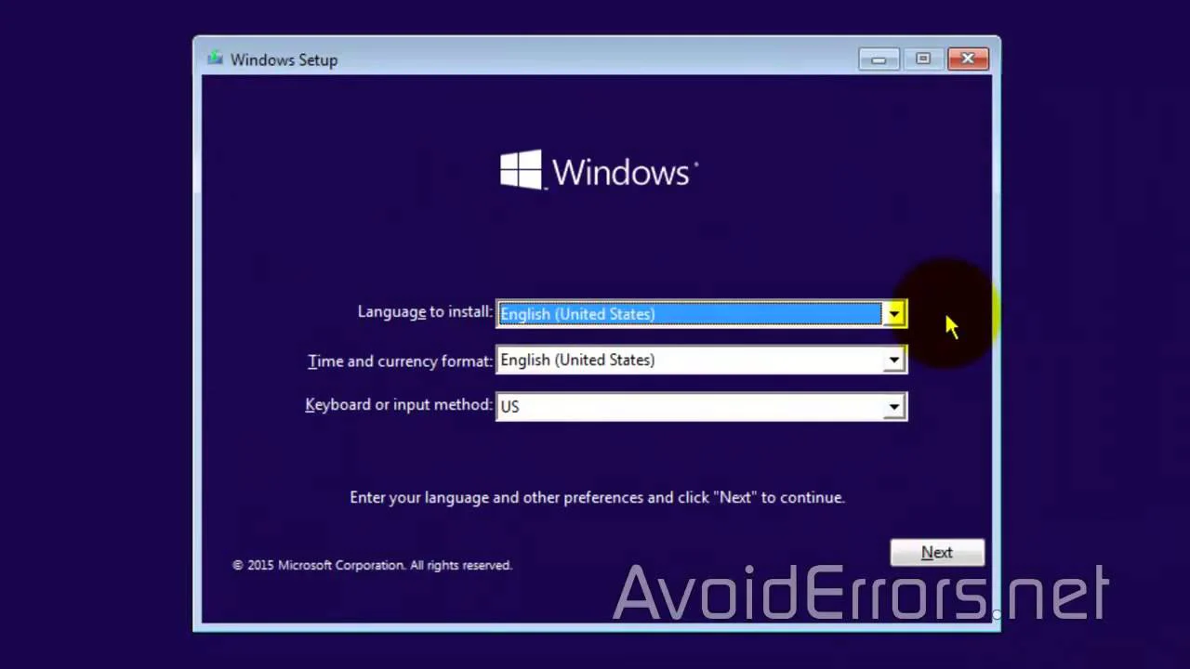

Slide 3
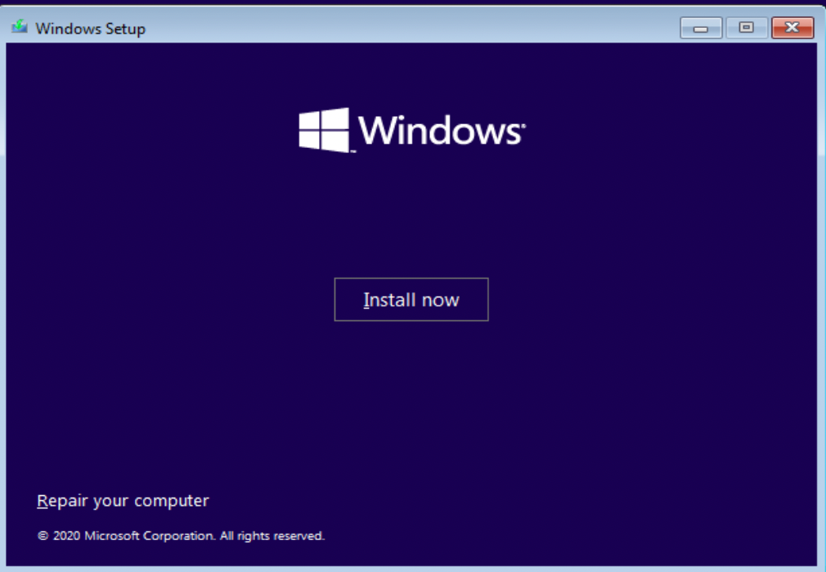

Slide 4
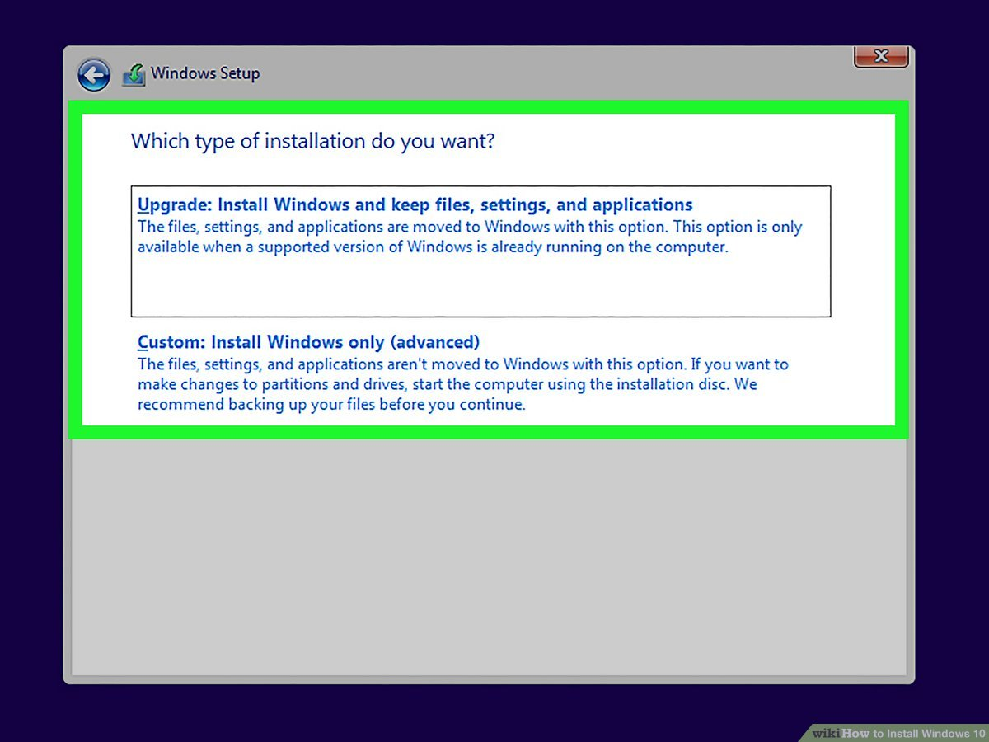

Slide 5
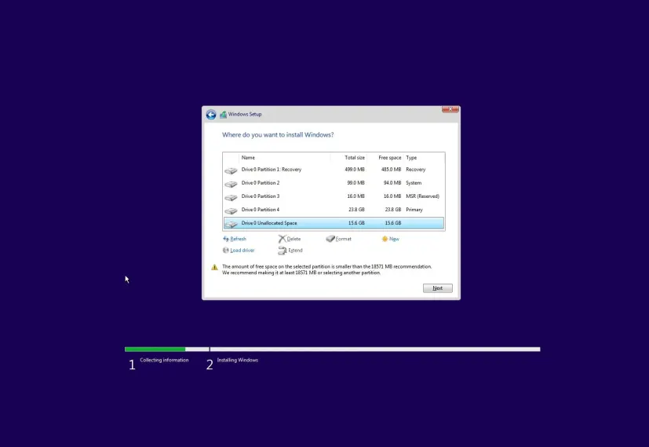

Slide 6
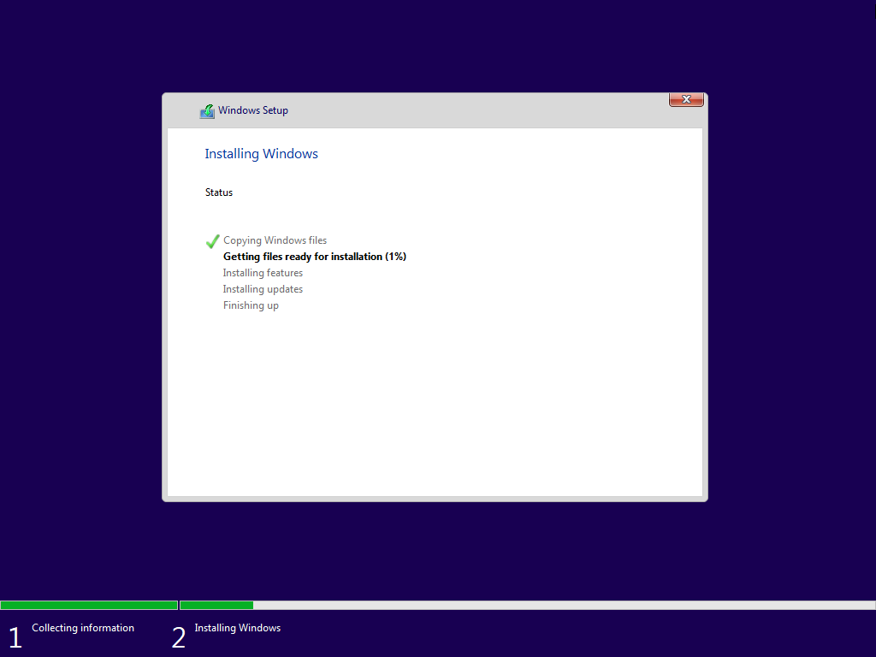

Slide 7
100%

Slide 8
100%
100%

Slide 9
100%
1%
100%

Slide 10
100%
10%
100%

Slide 11
100%
100%
100%

Slide 13
GETTING THINGS READY

Slide 14
SETTING UP DEVICES 50%

Slide 15
SETTING UP DEVICES 100%

Slide 16
RESTARTING…

Slide 17
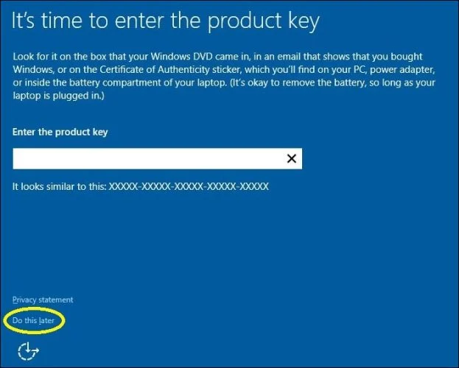

Slide 18
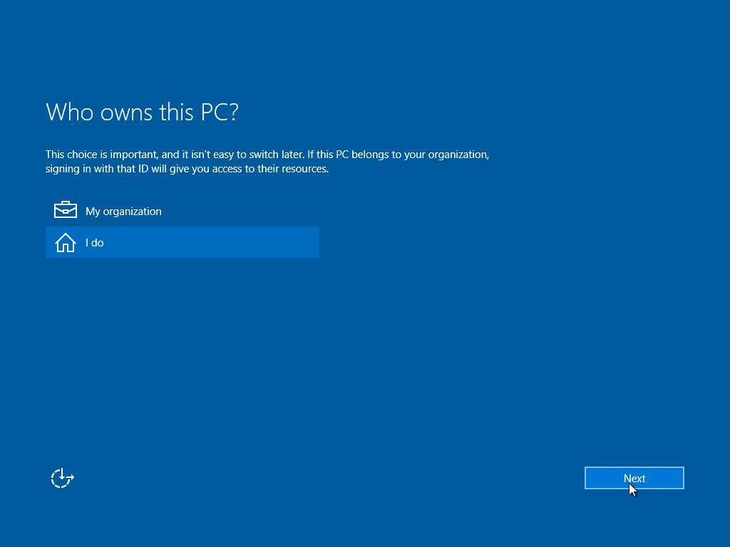

Slide 19
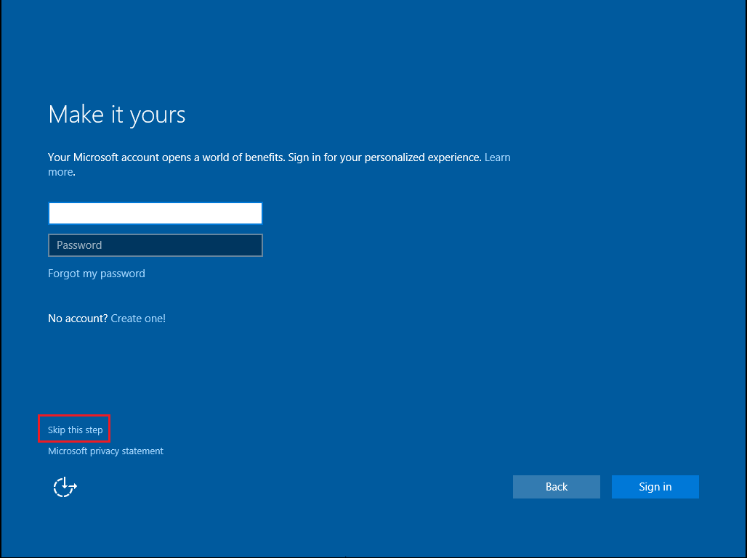

Slide 20
HI

Slide 21
WE ARE GETTING EVREYTHING READY FOR YOU

Slide 22
THIS WONT TAKE LONG
SETTING UP YOUR APPS

Slide 23
YOU CAN GET APPS FROM THE STORE
INSTALLING YOUR APPS…

Slide 24
ALMOST THRHE
I

Slide 25
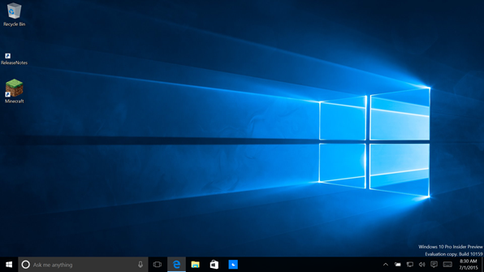

Slide 26
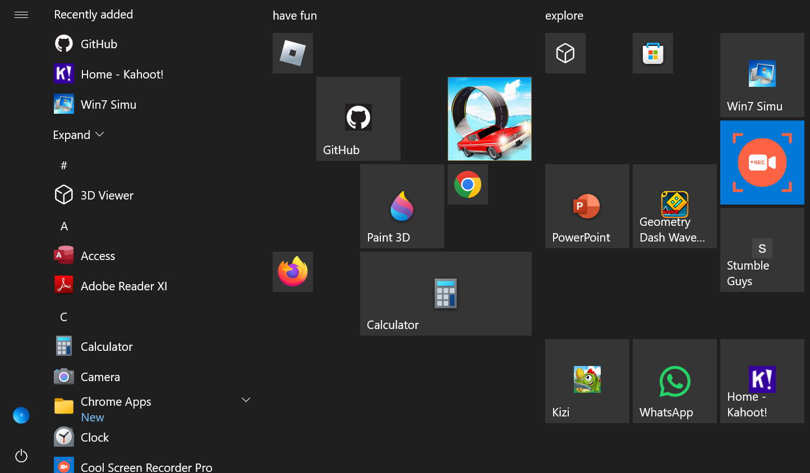

Slide 27


Slide 29


Slide 30


Slide 35


